Slide 1
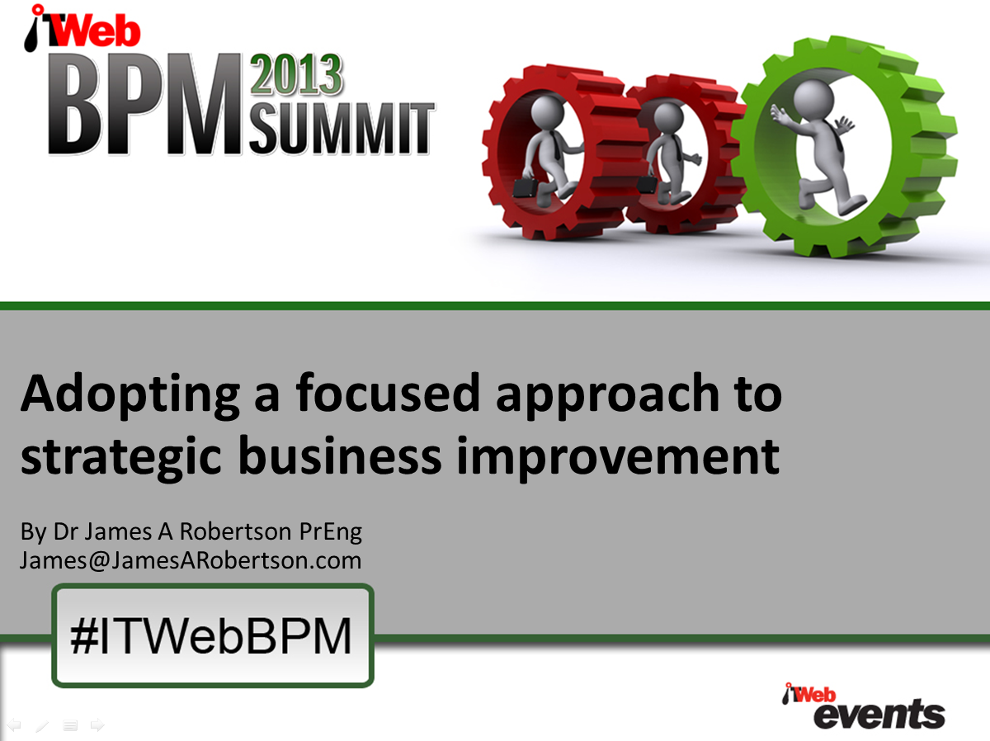

Slide 2
Agenda
Adopting a focused approach to strategic business improvement
What IS strategy?
What are markets and how do you measure Market Attractiveness and Market Critical Success Factors?
Strategic driving force
Why market focused strategy is THE fundamental arbiter of strategic change
How to drive business improvement from an understanding of Strategic Marketing fundamentals
Case study

Slide 3
Agenda
Adopting a focused approach to strategic business improvement
What IS strategy?

Slide 4
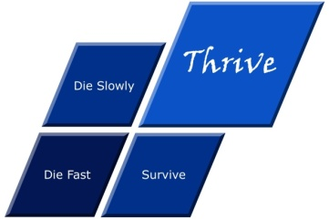


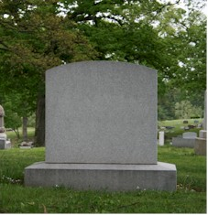


What is strategy?
Die fast
Thrive
Tactics – Doing things right ➔
Die
Die slowly
Survive
Strategy – Doing the right things ➔
Professor Malcolm McDonald – http://www.malcolm-mcdonald.com/

Slide 5
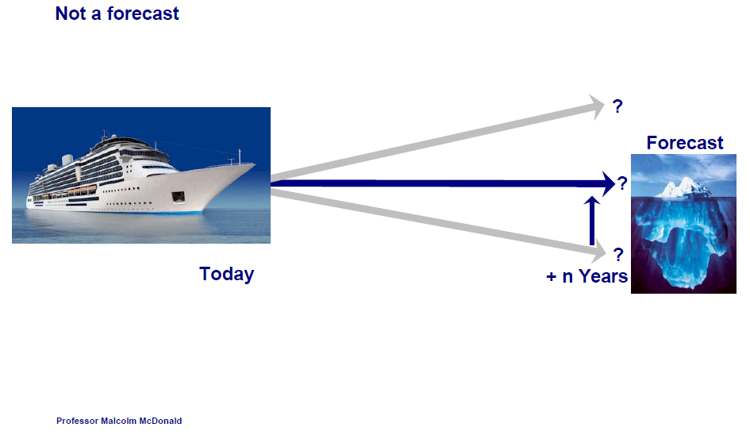
The time dependency of strategy
Professor Malcolm McDonald – http://www.malcolm-mcdonald.com/

Slide 6
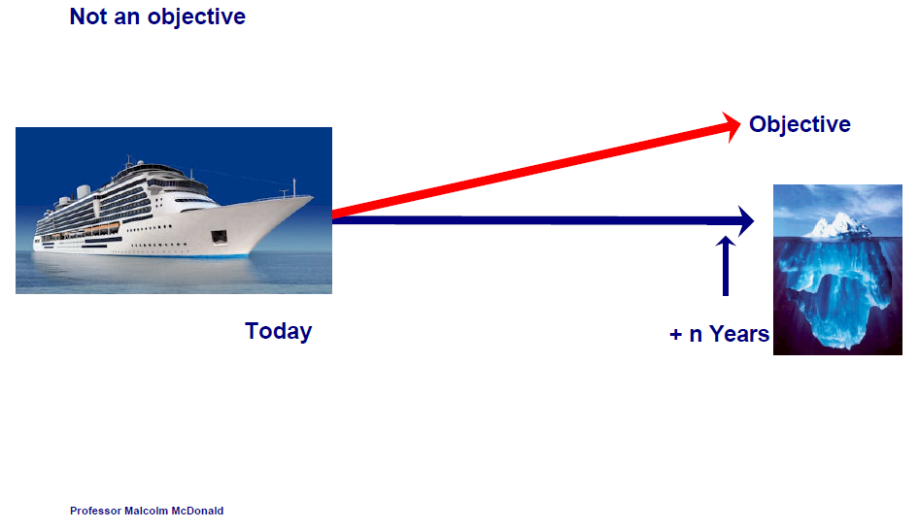
The time dependency of strategy
Professor Malcolm McDonald – http://www.malcolm-mcdonald.com/

Slide 7
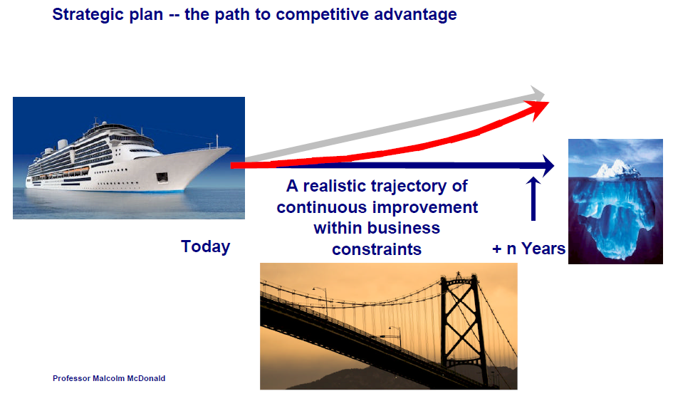
The time dependency of strategy
Professor Malcolm McDonald – http://www.malcolm-mcdonald.com/

Slide 8
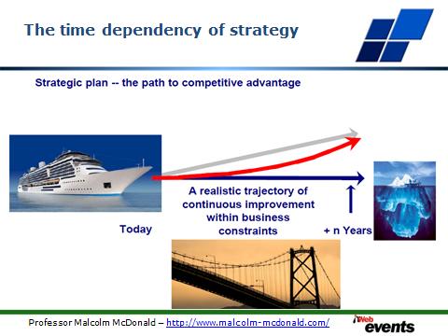
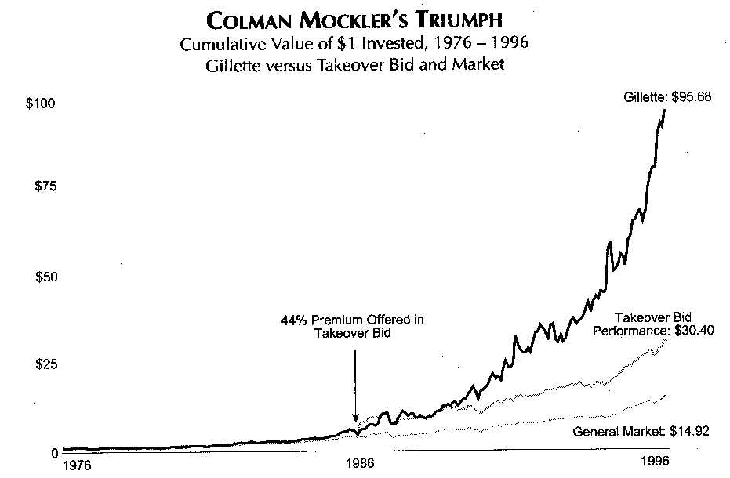

The time dependency of strategy
“From Good to GREAT” by Jim Collins
Gillette Case Study
1991
Mockler
Retires
1996
End of
Study
1975
Colman Mockler Appointed CEO
1986
Hostile Takeover Thwarted
“From Good to Great” by Jim Collins, page 24

Slide 9
Some vital considerations in designing and implementing strategic plans
Context to the presentation that follows
Vital principles that must be understood in order to develop and implement strategic plans that work
Consolidated view based on more than three decades of strategic experience

Slide 10

An ENGINEERING approach to strategy and business improvement
Notes:
There is a fundamental difference in approach when one designs a bridge NOT TO FALL DOWN
Contrast this with the IT paradigm which could be called “designed to fail”

Slide 11
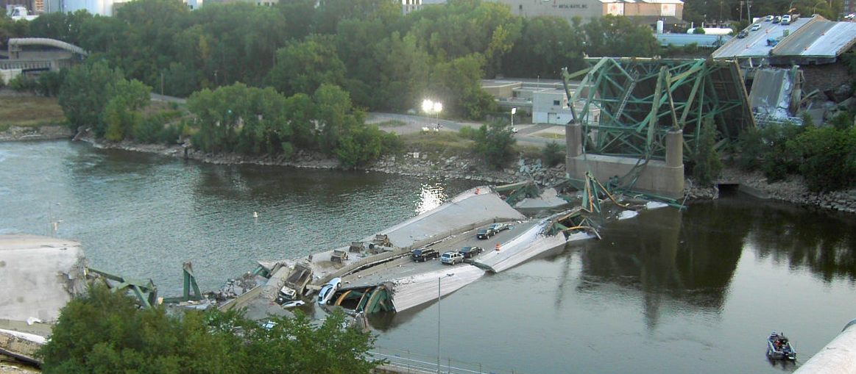

Engineers do NOT design bridges to stand up
Notes:
DHL, Prochem,

Slide 12
They design bridges NOT to fall down
Notes:
There is a fundamental difference in approach when one designs a bridge NOT TO FALL DOWN
Contrast this with the IT paradigm which could be called “designed to fail”

Slide 13

Some harsh facts
Seventy percent of I.T. investments fail TOTALLY
"19 out of 20 ERP implementations “do not deliver what was promised“
Seventy percent of BPM investments fail
Ninety percent of strategic plans fail
How does one prevent failure?
and thereby achieve SUCCESS?
Notes:
KEEP SHORT AND SIMPLE
MY FATHER
How did i get involved with computers? – my father was a visionary -- In 1981, having gathered over 7,000 pages of research data for my PhD the University mainframe did not have space to store even one page of data. My father purchased me one of the first desktop PC’s in the days of the Apple and Apricot and 123, etc – at a cost of R12,000 two and a half times my research grants! – I very quickly discovered that there was a HUGE gap between what the salesman told me the computer could do and getting it to do it – so, in that respect, NOTHING HAS CHANGED ☺ -- I then put myself through a self taught computer science programme and learned to program, learned to type and finally wrote an award winning PhD thesis – at the same time I computerized my father’s investment consulting business and we were able to double turnover in twelve months and create an enduring revenue stream that lasted for over ten years because we were able to do things that much larger businesses were not able to do – it was then that I began to understand that the strategic application of information technology COULD deliver great value and one of my greatest frustrations is the extent to which few businesses achieve this potential – the rest of this presentation is about lessons I have learned that I hope will help YOU to make a difference in your business with IT

Slide 14

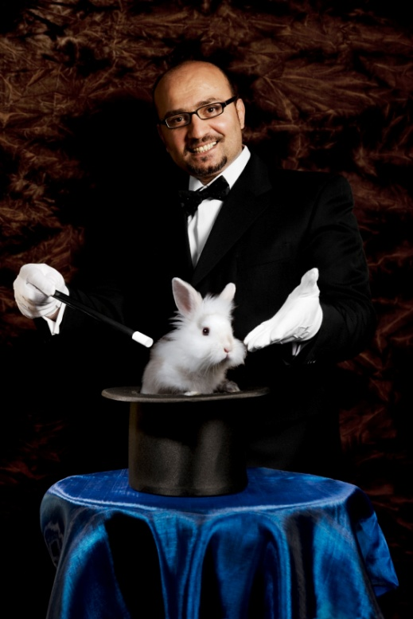

What is NOT an engineering approach?
Notes:
What is not an engineering approach? – Dramatically walk to chair – did this ever happen to you? –
WHEN SLEEPING
when i was a child i used to dream that i would stand on a chair and flap my arms and fly around the room --i have to say that that is NOT an engineering approach – as much as i may be convinced i can fly i have to say to you that were i to stand on top of a skyscraper and flap my arms and jump i would hit the ground at great speed and almost certainly die – that is NOT an engineering approach and yet many seem to think they can use software to do things magically – many are hypnotized and mesmerized by IT – are you? CLICK for rabbit out of the hat

Slide 15
What IS Strategy?
The Essence of WHY the Organization exists and HOW it THRIVES
Virtually NEVER changes
Intuited
Discovered NOT invented

Slide 16
Three alternative ERP value scenarios Unlocking the TRUE potential of ERP
100 / 1,000 x the norm ???
1,000
XXX 10
This is the ONLY valid scenario but it seldom occurs
3. Strategic customization
With CEO Custody
Relative strategic value measured in terms of business competitiveness, growth and profitability
2. Strategic precision configuration with CEO Executive Custody
1. Current industry norm for process based “Best Practice”
X 1
100
10
X 0.01
0
0
0

Slide 17
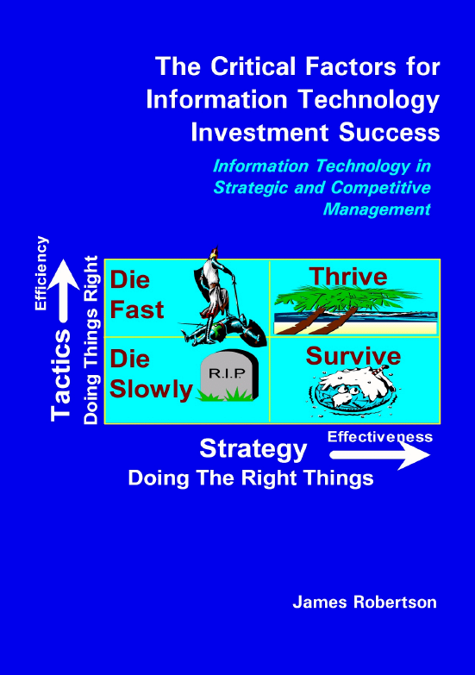
Analysis of findings of numerous Pulse Measurements
Email me for a copy
James@JamesARobertson.com
Notes:
WHAT CAUSES IT FAILURE?
Since 1993, analysed in 2003, course, book
Sustainable versus experimentation
People
The factors causing IT failure – in 1993 I became aware of the high failure rate of IT projects and started to talk about it – as a consequence i was asked to investigate many failed or failing projects and to help to turn them around – over the years i built up a large catalogue of the factors causing failure – in 2003 i undertook a critical issues analysis of the factors causing failure and arrived at a list of seven critical factors causing failure together with the critical factors for success which then became the subject of a course and subsequently a book – HOLD UP THE BOOK – since then i have advised many clients and led a number of significant projects and consistently validated the basic analysis
The biggest single factor causing failure is Mythology at 30% followed by lack of executive custody and inappropriate governance at 25%

Slide 18
Factors causing strategy implementation failure

Slide 19
Top down (CEO led) versus bottom up design
Top Down – Strategy Focused
Bottom Up – Process Focused

Slide 20
Factors for strategy implementation success
Information and documentation

Slide 21
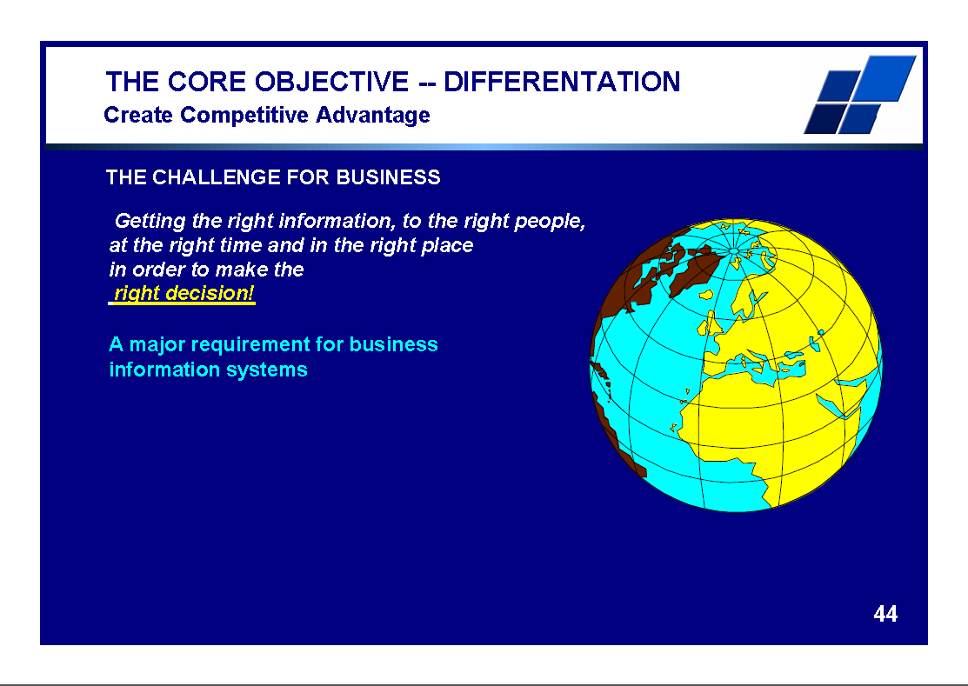
There IS great opportunity
ERP can and should add value
Notes:
Professor Richard Nolan states that "I.T. is the next corporate disaster waiting to happen”
And postulates that soon there will be an Enron level corporate failure
Do you remember Fedsure Health – tell the story SHORT

Slide 22
Determining the ESSENCE of the business and how it thrives
Experienced strategic facilitator
Interview each executive one on one starting with the CEO
“Please will you tell me the essence of your business and how it thrives – what differentiates you from your competition?”
Listen carefully – “active listen”
Take lots of notes
After completing the interviews synthesize ALL the views to arrive at a SINGLE SENTENCE amplified as necessary with further detail
If an executive differs with the CEO then, unless the CEO has just arrived, the CEO’s view must prevail, particularly if the CEO is the founder or has been there for many years
New executives can be FAR off the mark

Slide 23

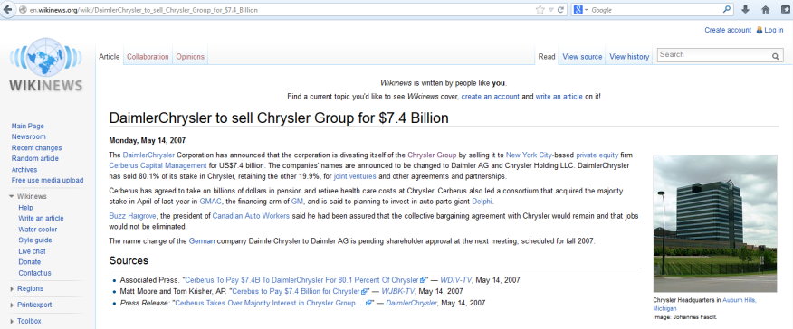
What is strategy?
Daimler Chrysler – FAILURE!
Daimler AG – Engineering Excellence
Chrysler – Technology Innovation
Not compatible
The essence of the business MUST be understood in any business improvement initiative
Failure to understand the strategic essence of the business is probably the single biggest factor in failed and sub-optimal business improvement initiatives

Slide 24
Agenda
Adopting a focused approach to strategic business improvement
What IS strategy?
What are markets and how do you measure Market Attractiveness and Market Critical Success Factors?

Slide 25
What are markets and how do you measure Market Attractiveness and Market Critical Success Factors?
Market – group of customers who respond in approximately the same way to a given offer
Market Attractiveness Factors – how a business should select its markets – what do we look for in a customer and therefore market
Customer Critical Success Factors – why customers buy our products as distinct from our competitors products – how we differentiate ourselves
Simple to determine with skillful facilitation

Slide 26
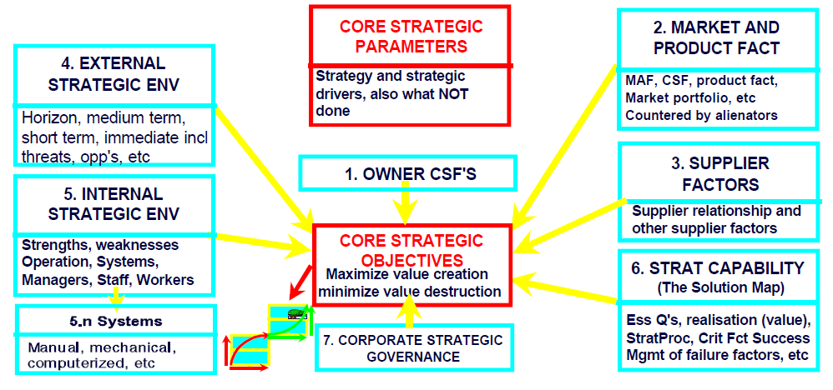
Analysis of the strategic environment

Slide 27
Agenda
Adopting a focused approach to strategic business improvement
What IS strategy?
What are markets and how do you measure Market Attractiveness and Market Critical Success Factors?
Strategic driving force

Slide 28
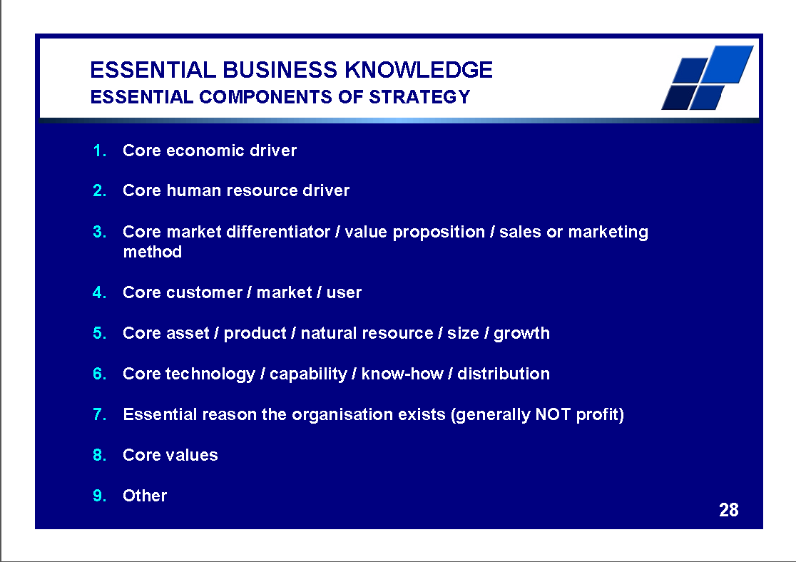
There IS great opportunity
ERP can and should add value
Refer ALSO Michel Robert on “Strategic Driving Force”
http://www.decisionprocesses.com/
Notes:
Professor Richard Nolan states that "I.T. is the next corporate disaster waiting to happen”
And postulates that soon there will be an Enron level corporate failure
Do you remember Fedsure Health – tell the story SHORT

Slide 29
Strategic driving force
Pick ‘n Pay
Woolworths
Edgars
What is the economic driver of each?

Slide 30
Agenda
Adopting a focused approach to strategic business improvement
What IS strategy?
What are markets and how do you measure Market Attractiveness and Market Critical Success Factors?
Strategic driving force
Why market focused strategy is THE fundamental arbiter of strategic change

Slide 31
Why market focused strategy is THE fundamental arbiter of strategic change
Customers make buying decisions
Informed by marketing and sales information
Driven by gut feel and personal preference
Such that a strategic foundation that is intuitively attractive succeeds
And one that is NOT, fails
Any business improvement initiative that ignores strategy is destined to fail

Slide 32
Agenda
Adopting a focused approach to strategic business improvement
What IS strategy?
What are markets and how do you measure Market Attractiveness and Market Critical Success Factors?
Strategic driving force
Why market focused strategy is THE fundamental arbiter of strategic change
How to drive business improvement from an understanding of Strategic Marketing fundamentals

Slide 33
How to drive business improvement from an understanding of Strategic Marketing fundamentals
Project must be strategically aligned – the essence of how it thrives
Facilitators / consultants MUST understand the strategy
The strategy must be understood and published (publicized) from the top down
Inherently executives are the custodians of the strategic view and must be engaged with

Slide 34
Agenda
Adopting a focused approach to strategic business improvement
What IS strategy?
What are markets and how do you measure Market Attractiveness and Market Critical Success Factors?
Strategic driving force
Why market focused strategy is THE fundamental arbiter of strategic change
How to drive business improvement from an understanding of Strategic Marketing fundamentals
Case study

Slide 35
Case study
Stalled Business Information System (ERP) implementation
Strategic driver of the client – exceptional service – “we will compensate you for late delivery”
Strategic driver of the software company – biggest player in their industry, average service is the norm
Totally incompatible strategically – could not see eye to eye – constant conflict – project getting in the way of the essence of the business – the strategy
Project terminated
New software supplier – “if a problem with our software results in late delivery we will compensate you”

Slide 36
Summing up
Strategy is the essence of the business and how it thrives
Strategy is intuited in response to real customer needs
Business improvements that are strategically aligned and focused (essence of the business) will enable the business to thrive
Actions that compromise or prejudice the strategic essence of the business will damage the business
Most business improvement initiatives FAIL to recognize this reality and therefore fail to deliver on their potential

Slide 37

If you do not act within 48 hours you probably never will (Bill Gates)
Act TODAY! ☺
What is your single most important insight from this presentation?
What is the single most practical action that you can take tomorrow to apply strategic (right thing / essence thinking) more effectively?
Please write down your thoughts
NOW

Slide 38
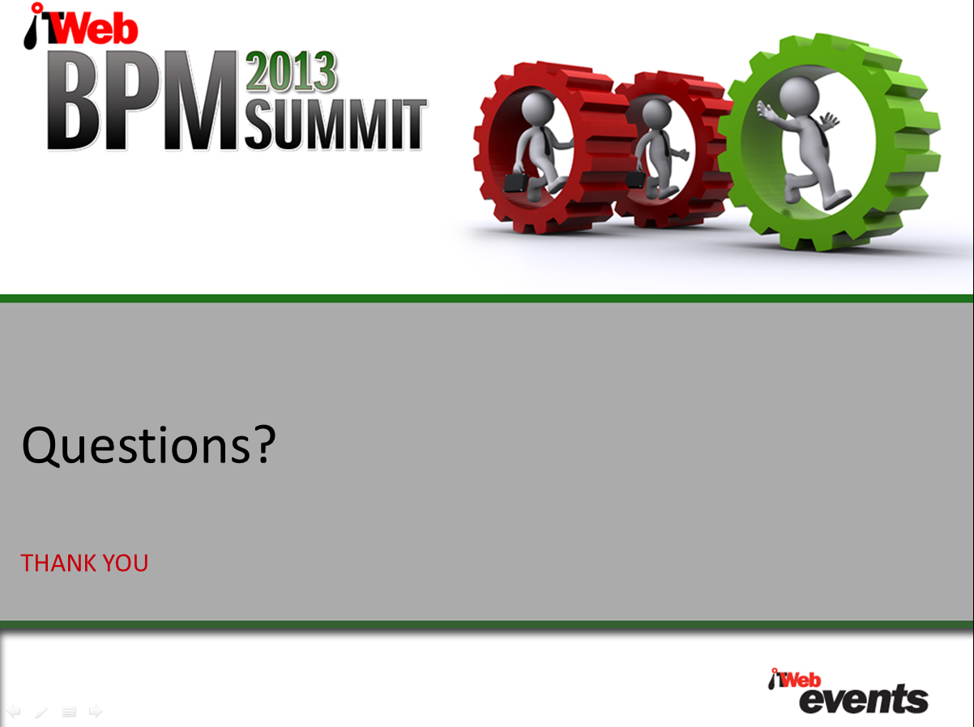
James@JamesARobertson.com

